Slide 1
Agile Development and Human Aspects of
Software Engineering
Session 04
Course : Software Engineering
Effective Period : Desember 2017

Slide 2
These slides have been adapted from
Pressman, R.S. (2015). Software Engineering : A Practioner's Approach. 8th ed. McGraw-Hill Companies.Inc, Americas, New York. ISBN : 978 1 259 253157. Chapter 5 and 6
Acknowledgement

Slide 3
LO 1 : Describe the concepts of software process models
Learning Objectives

Slide 4
Contents
What is “Agility”?
Agility and the Cost of Change
Agile Process
Extreme Programming (XP)
Adaptive Software Development
Dynamic Systems Development Method
Scrum
Crystal
Feature Driven Development
Agile Modeling
Human Aspects of Software Engineering

Slide 5
What is “Agility”?
Effective (rapid and adaptive) response to change
Effective communication among all stakeholders
Drawing the customer onto the team
Organizing a team so that it is in control of the work performed
Yielding …
Rapid, incremental delivery of software

Slide 6

Agility and the Cost of Change

Slide 7
Agile Process
Is driven by customer descriptions of what is required (scenarios)
Recognizes that plans are short-lived
Develops software iteratively with a heavy emphasis on construction activities
Delivers multiple ‘software increments’
Adapts as changes occur

Slide 8
Agile Process
Agility Principles
1. Our highest priority is to satisfy the customer through early and continuous delivery of valuable software.
2. Welcome changing requirements, even late in development. Agile processes harness change for the customer's competitive advantage.
3. Deliver working software frequently, from a couple of weeks to a couple of months, with a preference to the shorter timescale.
4. Business people and developers must work together daily throughout the project.
5. Build projects around motivated individuals. Give them the environment and support they need, and trust them to get the job done.
6. The most efficient and effective method of conveying information to and within a development team is face–to–face conversation.

Slide 9
Agile Process
Agility Principles
7. Working software is the primary measure of progress.
8. Agile processes promote sustainable development. The sponsors, developers, and users should be able to maintain a constant pace indefinitely.
9. Continuous attention to technical excellence and good design enhances agility.
10. Simplicity – the art of maximizing the amount of work not done – is essential.
11. The best architectures, requirements, and designs emerge from self–organizing teams.
12. At regular intervals, the team reflects on how to become more effective, then tunes and adjusts its behavior accordingly.

Slide 10
Extreme Programming (XP)
The most widely used agile process, originally proposed by Kent Beck
XP Planning
  Begins with the creation of “user stories”
  Agile team assesses each story and assigns a cost
  Stories are grouped to for a deliverable increment
  A commitment is made on delivery date
  After the first increment “project velocity” is used to help define subsequent delivery dates for other increments

Slide 11
Extreme Programming (XP)
XP Design
  Follows the KIS principle
  Encourage the use of CRC cards (see Chapter 8)
  For difficult design problems, suggests the creation of “spike solutions”—a design prototype
  Encourages “refactoring”—an iterative refinement of the internal program design
XP Coding
  Recommends the construction of a unit test for a store before coding commences
  Encourages “pair programming”
XP Testing
  All unit tests are executed daily
  “Acceptance tests” are defined by the customer and executed to assess customer visible functionality

Slide 12

Extreme Programming (XP)

Slide 13
Adaptive Software Development
Originally proposed by Jim Highsmith
ASD — distinguishing features
  Mission-driven planning
  Component-based focus
  Uses “time-boxing”
  Explicit consideration of risks
  Emphasizes collaboration for requirements gathering
  Emphasizes “learning” throughout the process

Slide 14
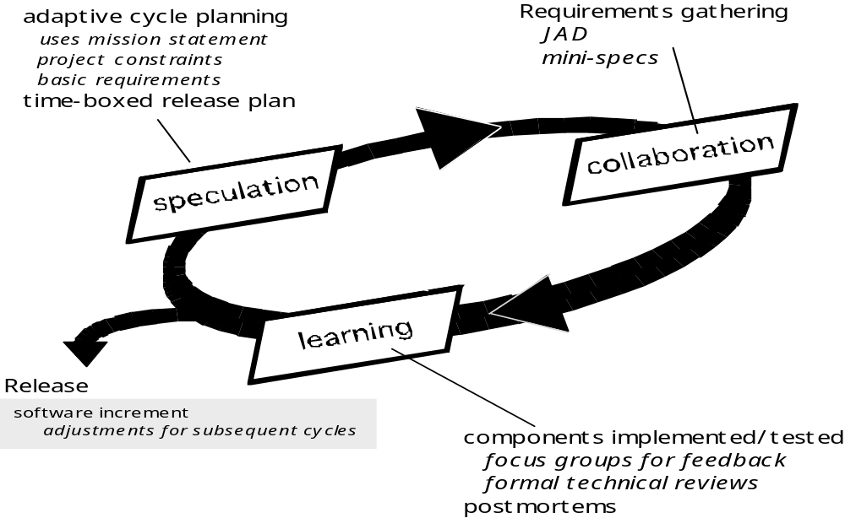
Adaptive Software Development

Slide 15
Dynamic Systems Development Method
Promoted by the DSDM Consortium (www.dsdm.org)
DSDM—distinguishing features
  Similar in most respects to XP and/or ASD
  Nine guiding principles
    Active user involvement is imperative.
    DSDM teams must be empowered to make decisions.
    The focus is on frequent delivery of products.
    Fitness for business purpose is the essential criterion for acceptance of deliverables.
    Iterative and incremental development is necessary to converge on an accurate business solution.
    All changes during development are reversible.
    Requirements are baselined at a high level
    Testing is integrated throughout the life-cycle.

Slide 16
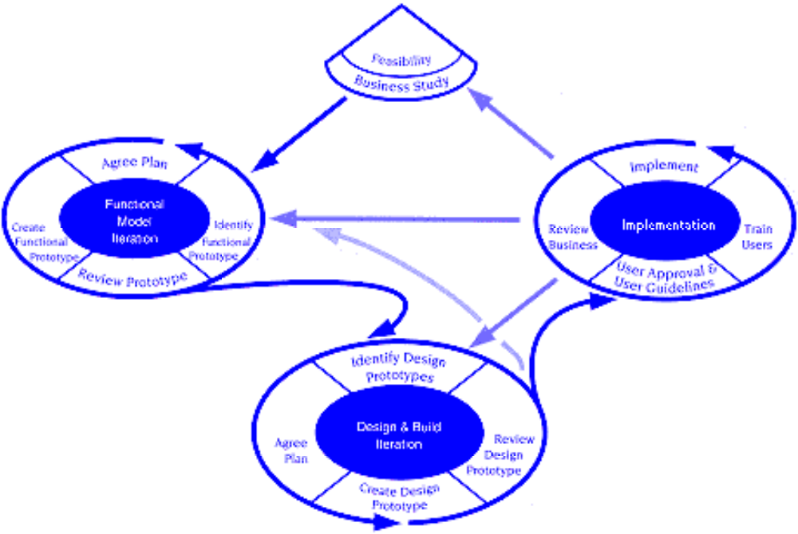
Dynamic Systems Development Method
DSDM Life Cycle (with permission of the DSDM consortium)

Slide 17
Scrum
Originally proposed by Schwaber and Beedle
Scrum—distinguishing features
  Development work is partitioned into “packets”
  Testing and documentation are on-going as the product is constructed
  Work occurs in “sprints” and is derived from a “backlog” of existing requirements
  Meetings are very short and sometimes conducted without chairs
  “demos” are delivered to the customer with the time-box allocated

Slide 18
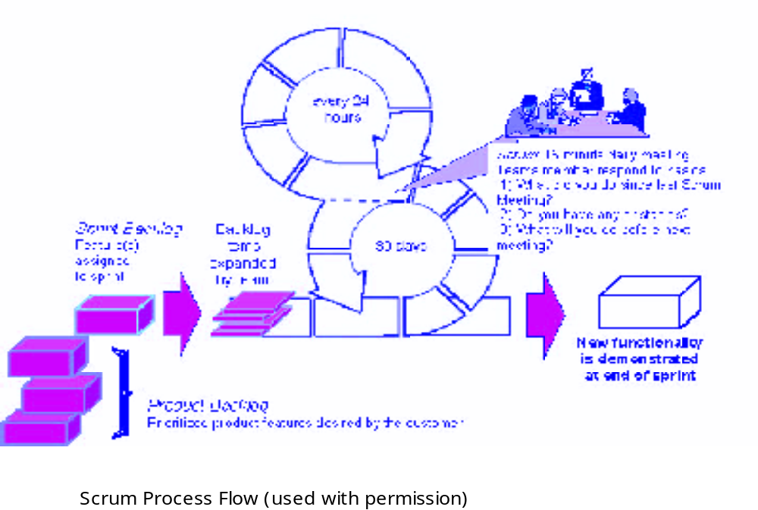
Scrum

Slide 19
Crystal
Proposed by Cockburn and Highsmith
Crystal—distinguishing features
  Actually a family of process models that allow “maneuverability” based on problem characteristics
  Face-to-face communication is emphasized
  Suggests the use of “reflection workshops” to review the work habits of the team

Slide 20
Feature Driven Development
Originally proposed by Peter Coad et al
FDD—distinguishing features
  Emphasis is on defining “features”
    a feature “is a client-valued function that can be implemented in two weeks or less.”
  Uses a feature template
    <action> the <result> <by | for | of | to> a(n) <object>
  A features list is created and “plan by feature” is conducted
  Design and construction merge in FDD

Slide 21
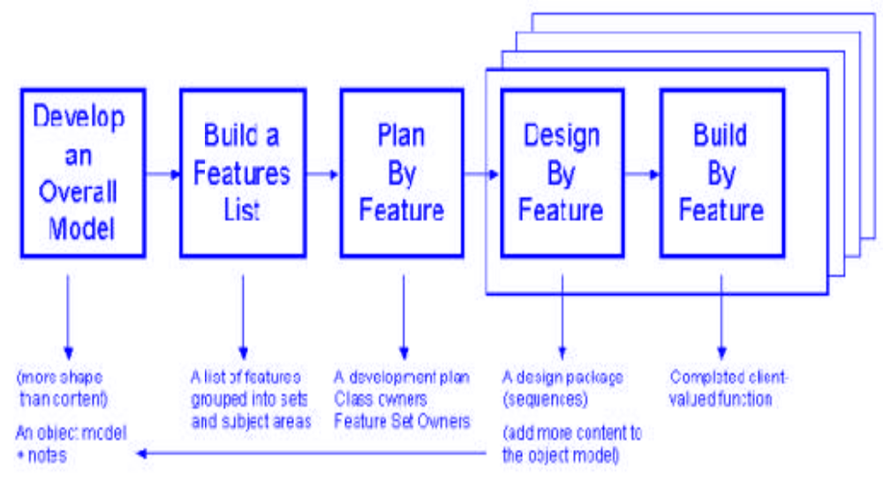
Feature Driven Development
Reprinted with permission of Peter Coad

Slide 22
Agile Modeling
Originally proposed by Scott Ambler
Suggests a set of agile modeling principles
  Model with a purpose
  Use multiple models
  Travel light
  Content is more important than representation
  Know the models and the tools you use to create them
  Adapt locally

Slide 23
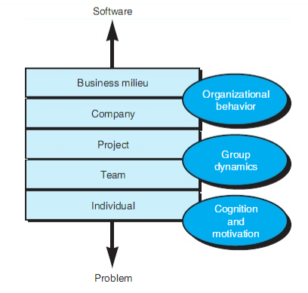
The Psychology of Software Engineering
Human Aspects of
Software Engineering
In a seminal paper on the psychology of software engineering, Bill curtis and Dave Walz [Cur90] suggest a layered behavioral model for software development.

Slide 24
The Software Team
Human Aspects of
Software Engineering
An effective team should foster a sense of trust
Software engineers on the team should trust the skills and competence of their peers and their managers.
The team should encourage a sense of improvement by periodically reflecting on its approach to software engineering and looking for ways to improve their work

Slide 25
Team Structure
Human Aspects of
Software Engineering
Constantine [Con93] suggests four “organizational paradigms” for software engineering teams
A closed paradigm; a team along a traditional hierarchy of authority
A random paradigm; a team loosely and depends on individual initiative of the team members
An open paradigm; a team in a manner that achieves some of the controls associated with the closed paradigm but also much of the innovation that occurs when using the random paradigm
A synchronous paradigm; relies on the natural compartmentalization of a problem and organizes team members to work on pieces of the problem with little active communication amonjg themselves

Slide 26
References
Pressman, R.S. (2015). Software Engineering : A Practioner's Approach. 8th ed. McGraw-Hill Companies.Inc, Americas, New York. ISBN : 978 1 259 253157.
Agile Modelling Best Practices, http://www.agilemodeling.com/essays/bestPractices.htm
Agile Process
http://www.objectmentor.com/resources/articles/agileProcess.pdf

Slide 27
Q & A

